Slide 1
Meeting 31

Slide 2
Agenda
Optimising all parameters
Optimising occurrence parameters only
Optimising amount parameters only with optimised occurrence parameters
Look into rainfall-runoff behaviours
Concluding of the pilot study
Meeting break

Slide 3
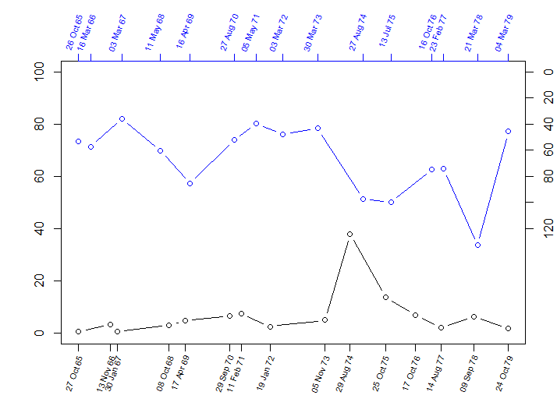
Annual Maxima Rainfall (1965-1979)
Runoff (mm)
Rain (mm)
Obs Rain
Vir.Obs. Runoff
Annual Maxima Runoff (1965-1979)

Slide 4
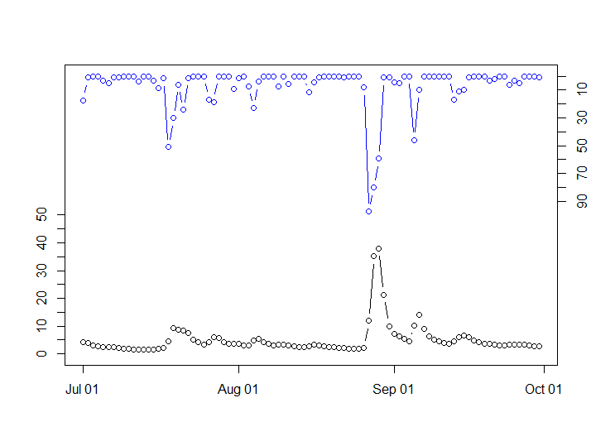
Daily Rainfall (01 July 1974 – 30 Sep 1974)
Obs Rain
Runoff (mm)
Vir.Obs Runoff
Rain (mm)
Daily Runoff (01 July 1974 – 30 Sep 1974)

Slide 5
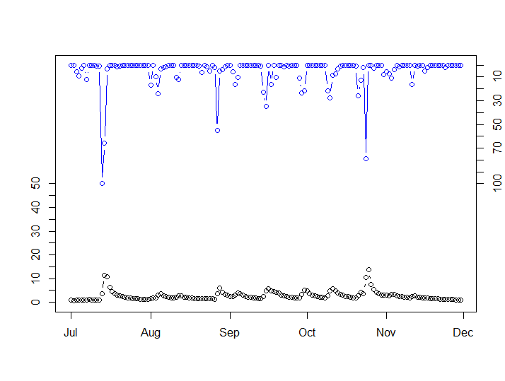
Daily Rainfall (01 July 1975 – 30 Nov 1975)
Runoff (mm)
Rain (mm)
Obs Rain
Vir.Obs. Runoff
Daily Runoff (01 July 1975 – 30 Nov 1975)

Slide 6
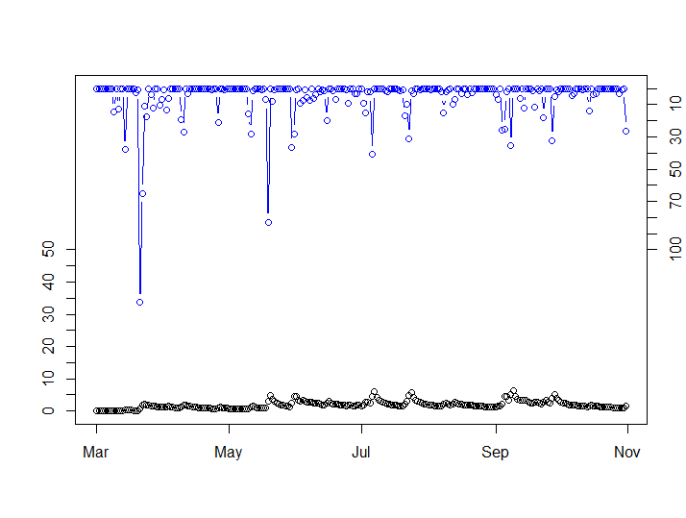
Daily Rainfall (01 Mar 1978 – 31 Oct 1978)
Runoff (mm)
Rain (mm)
Obs Rain
Vir.Obs. Runoff
Daily Runoff (01 July 1978 – 31 Oct 1978)

Slide 7
Concluding the pilot study
Motivation: presenting a case where “good” model rainfall translate to “bad” runoff
Items to be introduced: the models used in the pilot study: WGEN, GR4J, virtual observed streamflow, hydrological calibration procedure
Outcome of the calibration: it is feasible to calibrate a rainfall model with streamflow statistics (the flow duration curve). The process can be applied to other stochastic rainfall models and rainfall-runoff models.
Limitation: the use of SSE for objective function that tends to favour high flows, opportunities for future experiments: a different objective function, a different optimiser, other streamflow statistics

Slide 8
Meeting break
24 December
31 December
07 January

